Slide 1


INFO 6150 FINAL PROJECT
Happy Paw Rescue
FANYE SUN：002763553
YIFEI CHEN：002749660
JIALE LYU：002722692

Slide 2
·Contents·
01.
PROJECT BACKGROUND
Problems we are facing and out solutions
02.
MODELS
show models and diagrams
03.
ENTITIES
the content of enterprises and organizations
04.
USE CASE
display use case

Slide 3

PART-01
PROJECT BACKGROUND
Problems we are facing and out solutions

Slide 4
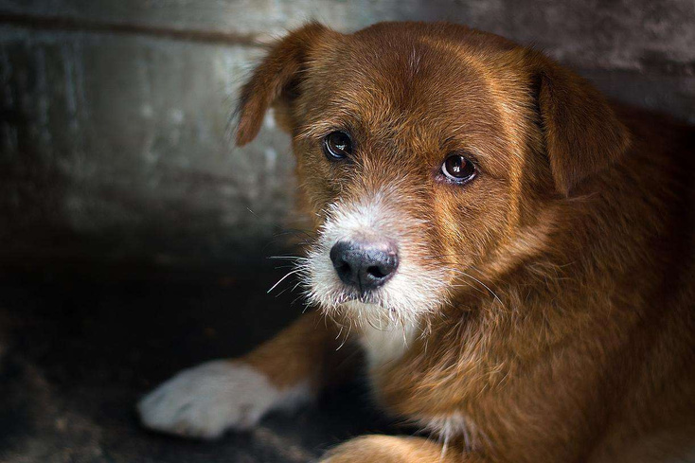
PROBLEMS
STRAY ANIMALS DESTROY THE ECOLOGICAL ENVIRONMENT
In the United States, 1.4 billion to 3.7 billion birds and 6.9 billion to 20.7 billion mammals are killed by stray cats and domestic cats every year, most of which are caused by stray cats and dogs. The overall US adoption rate was between 37% and 41%.
THE NUMBER OF
ANIMAL AOPTION
STREET ANIMAL MORTALITY
Street animals have a high mortality rate because they have no fixed food source and safe environment.
More than 23 million American households, which is 1 out of 5, has adopted an animal during 2022.

Slide 5

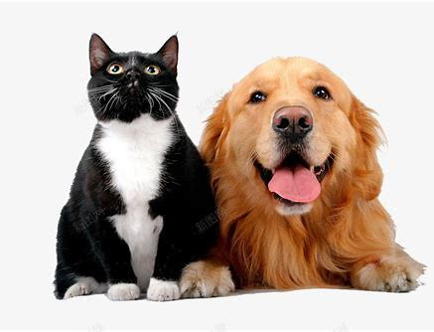
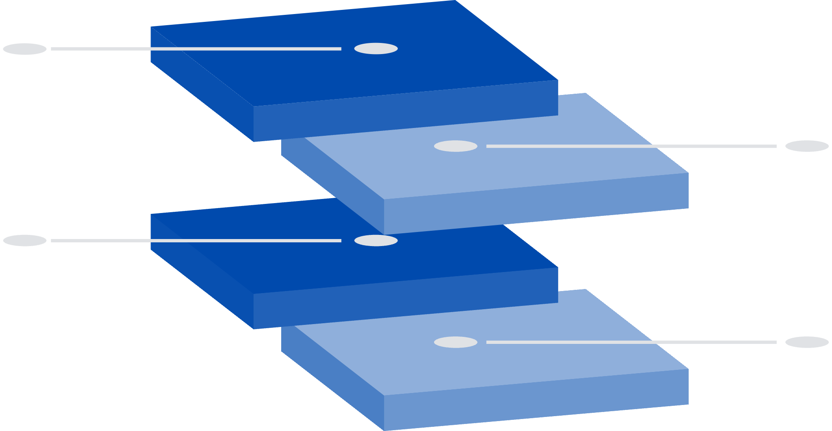
SOLUTIONS
COMBINATON
We combine these problems together and provide a system that makes the process of adopting stray animals easy and convenient.
CONSIDERATION
We consider the use case from rescuers, medical checkers, volunteers, and adopters. At the same time, with the use case of system administrator, this system is expandable at the global level.
PURPOSE
The purpose of our system is to make sure the animal is healthy both mentally and physically and verify the adopter is qualified before accessing the animal's information at the same time. We also provide the opportunity to volunteer and the volunteers could process their work independently.
ANIMAL
Every animal is responsible by a single manager, the manager is permitted to have an overview of an animal.

Slide 6
PART-02
MODELS
show models and diagrams

Slide 7
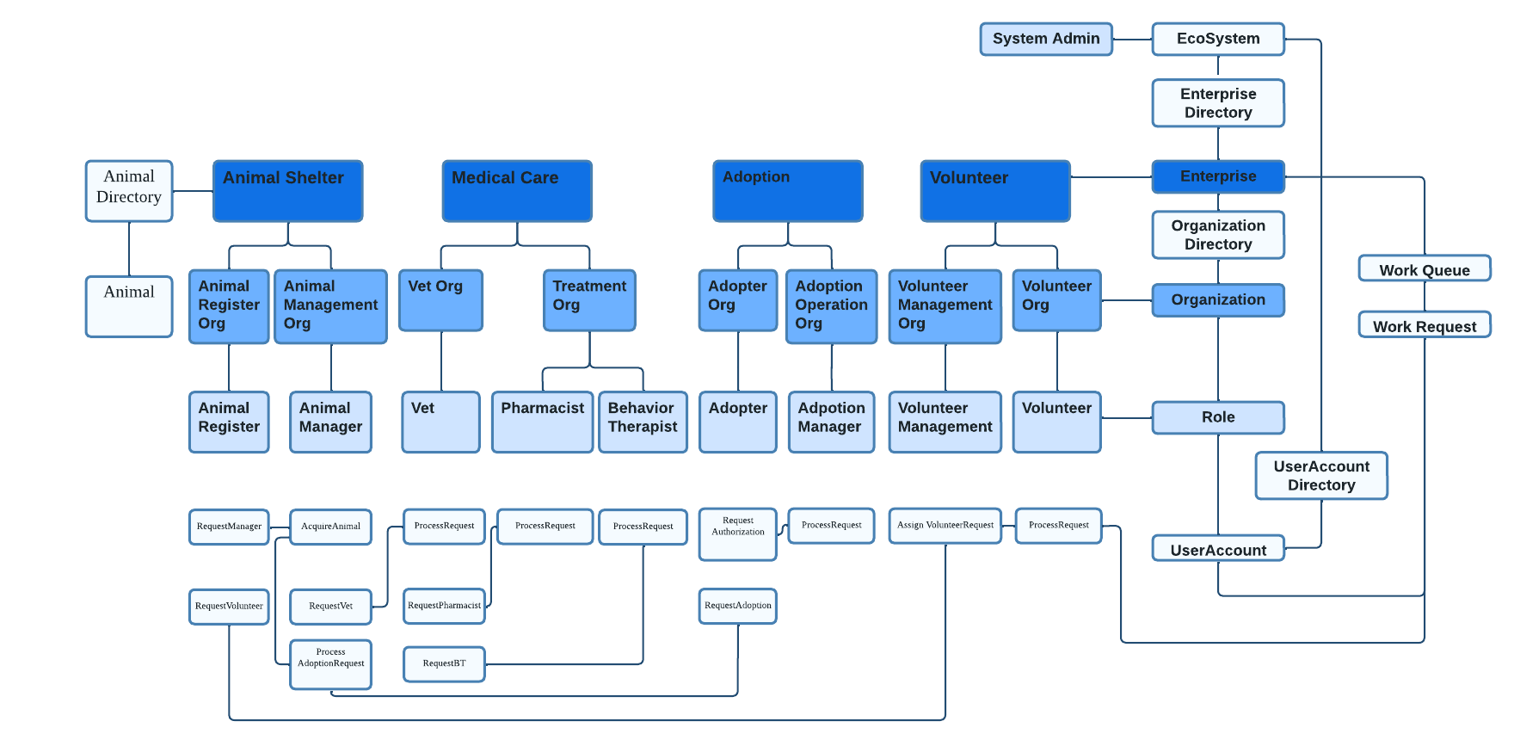
UML MODEL

Slide 8
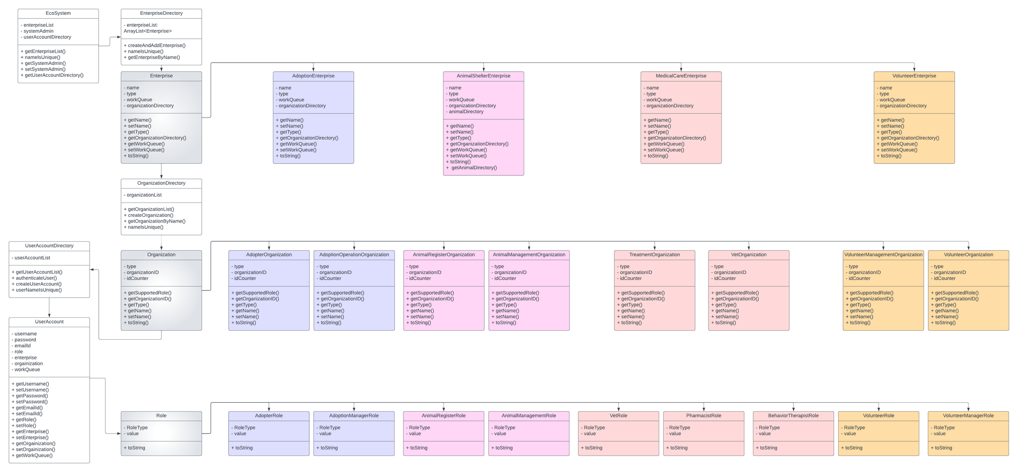
CLASS DESIGN MODEL

Slide 9
PART-03
ENTITIES
the content of enterprises, organizations and role

Slide 10

ENTERPRISE
ORGANIZATION
USER
System Admin:
service structure
DASHBOARD

Slide 11
System Admin
Admin
populate the structure

Slide 12

Enterprises
ANIMAL SHELTER
MEDICAL CARE
ADOPTION ENTERPRISE
VOLUNTEER ENTERPRISE

Slide 13
Animal Shelter
01
Animal register
02
Animal manager
add animals which are rescued into system
request volunteers
take responsibility of each animal

Slide 14
Medical Care
01
Vet Organization
02
Treatment Organization
be responsible for the treatment of animals and the first step of medical examination
Pharmacy, provide medicine and give additional treatment for animals in need of rescue
03
Treatment Organization
Behavior therapist, analyze the behavior of animals in need of rescue and provide advance check

Slide 15
Adoption Enterprise
01
Adopter Organization
02
Adoption Operation Organization
check status and request
approve adopter accounts

Slide 16
Volunteer Enterprise
01
Volunteer
02
Volunteer Manager
get job and report process
assign volunteer tasks

Slide 17
PART-04
USE CASE

Slide 18
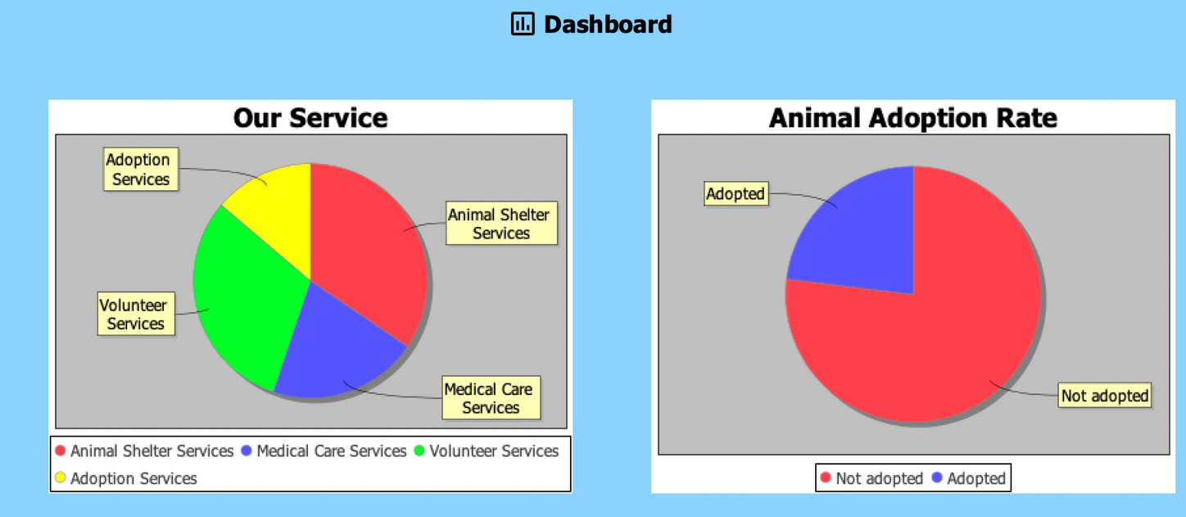
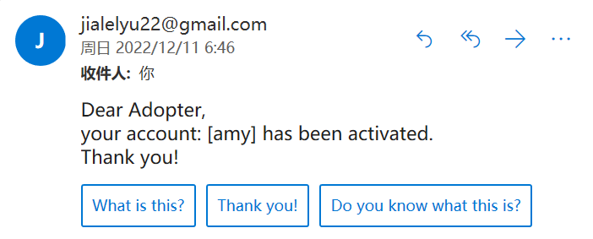
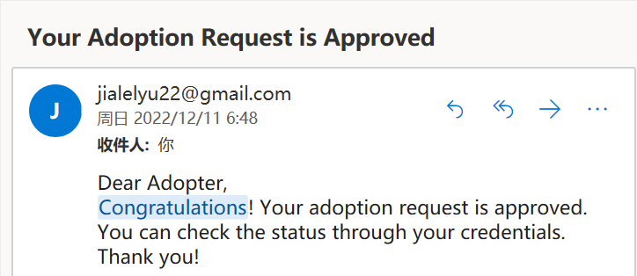
Advance Feature
SERVICE OVERFLOW
EMAIL VERIFICATION
Account Validation

Slide 19
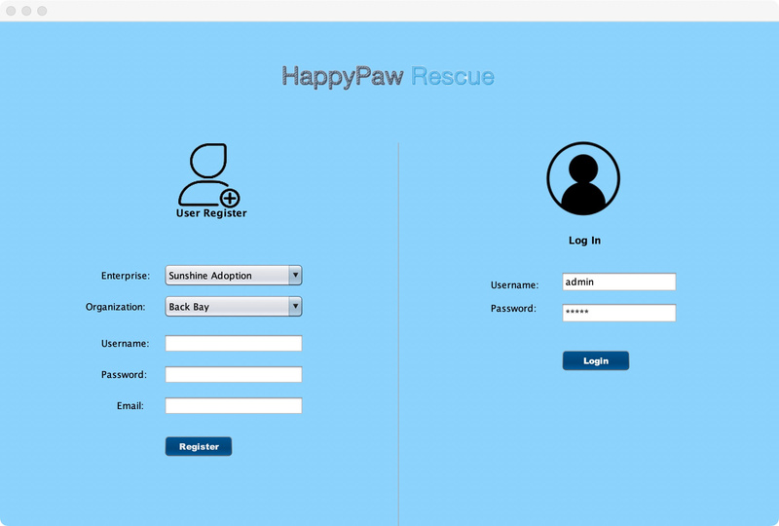
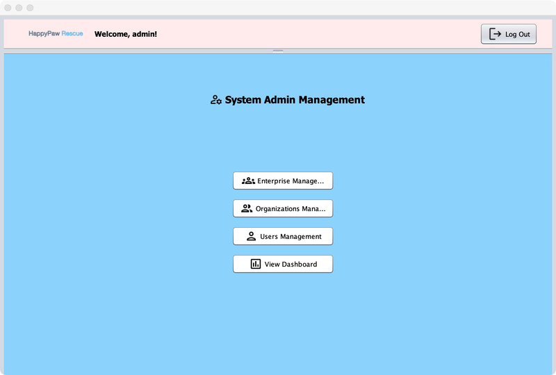
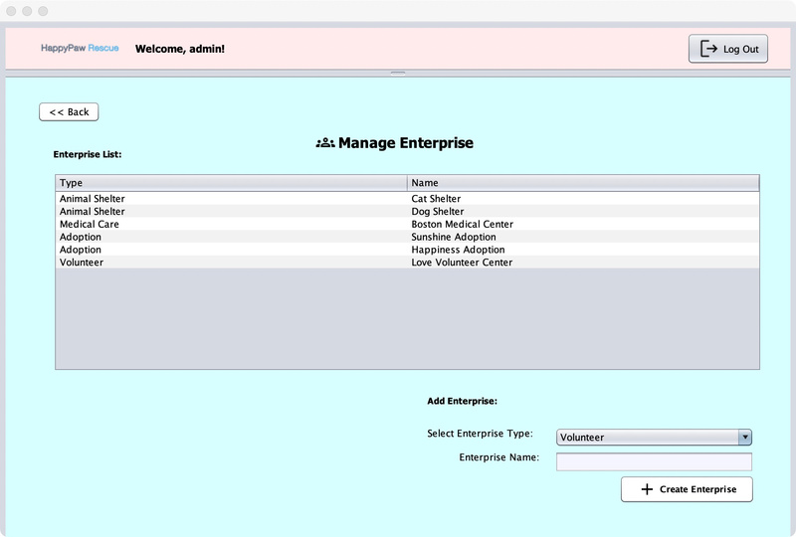
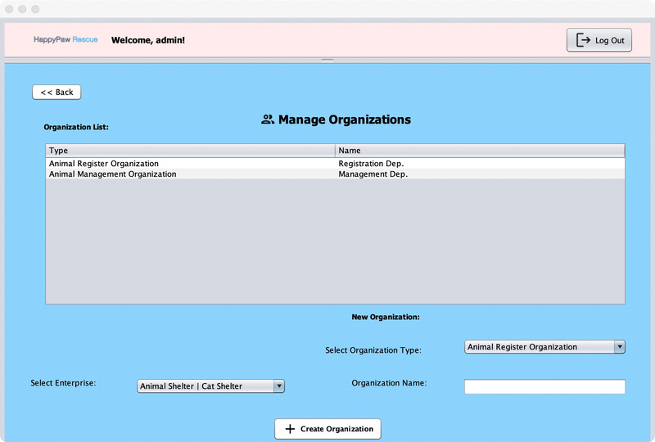
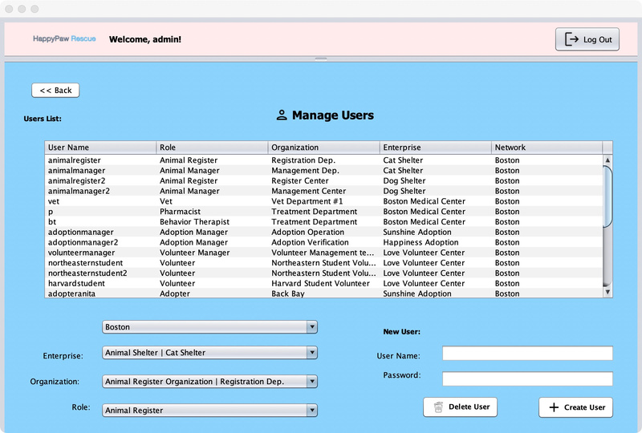
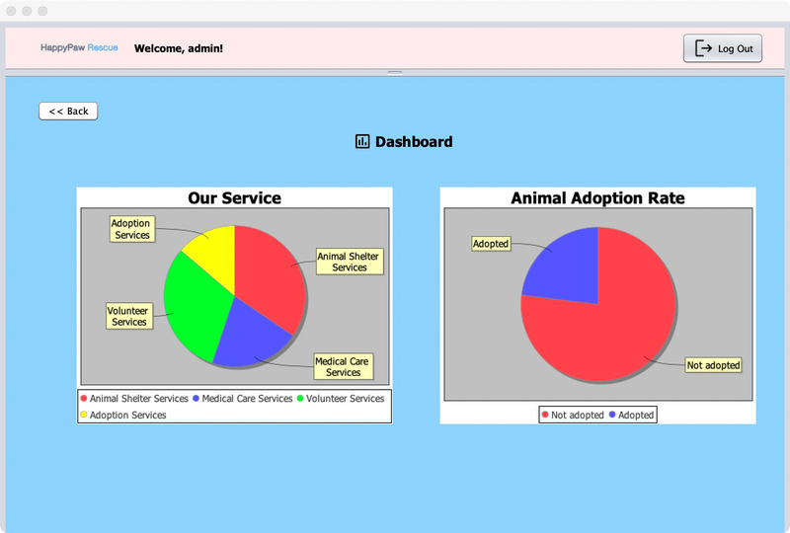
System Admin
Login page
Choose task
Create Enterprise
Create Organization
Create and delete User
View Dashboard

Slide 20

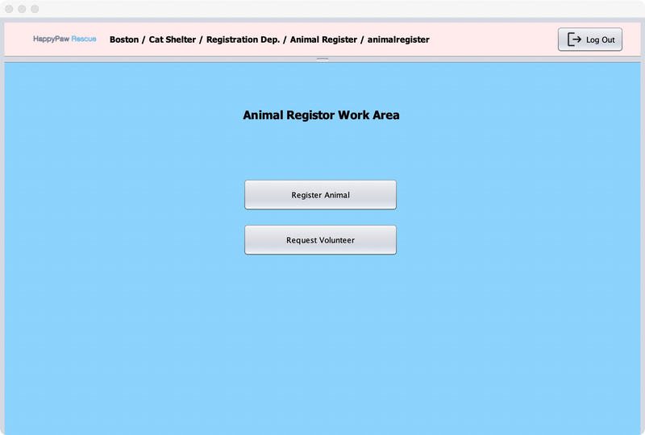
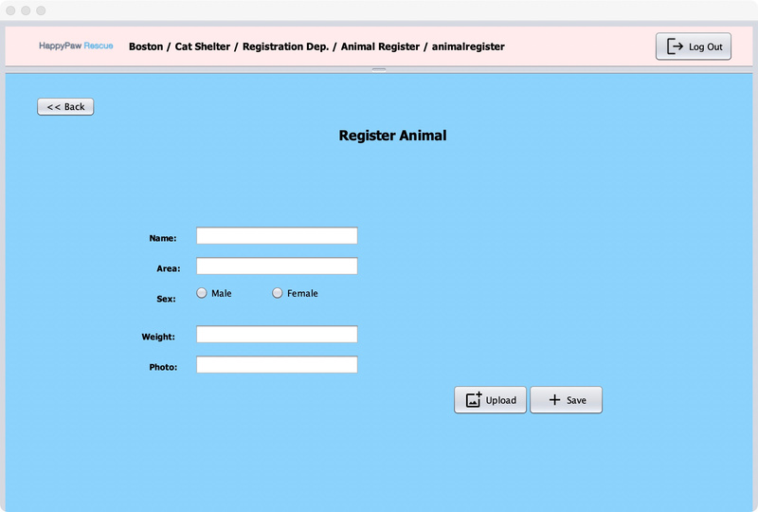
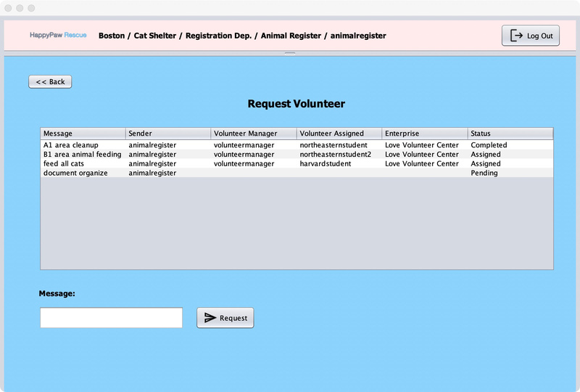
Animal Register
Login page
Choose task
Register Animal
Request volunteer

Slide 21
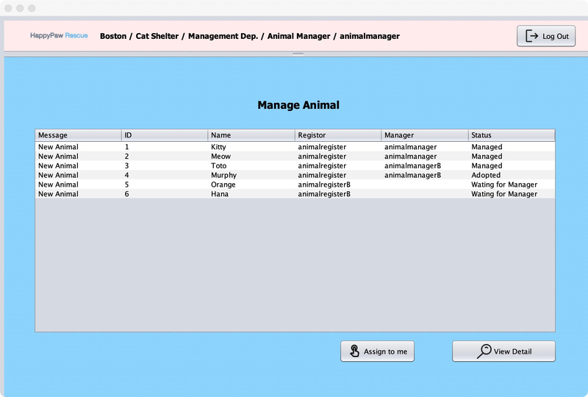
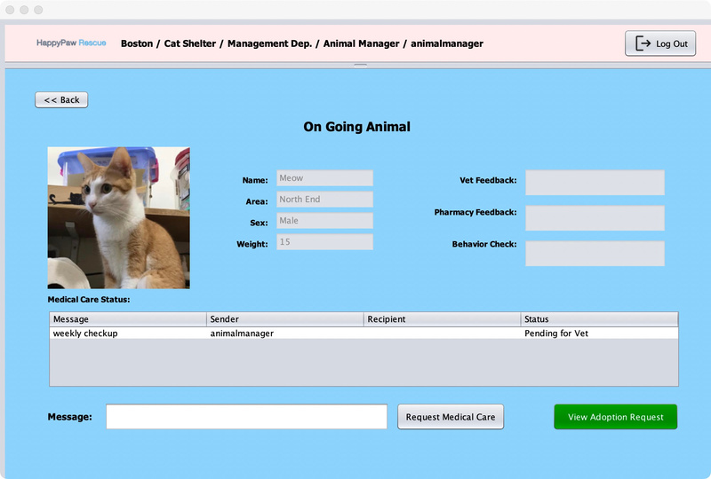
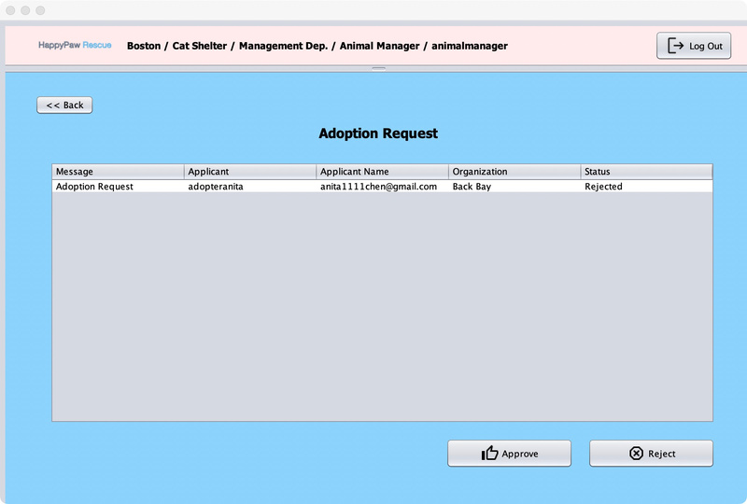
Animal Manager
Login page
Manage animals
View animals
Process Adoption request

Slide 22
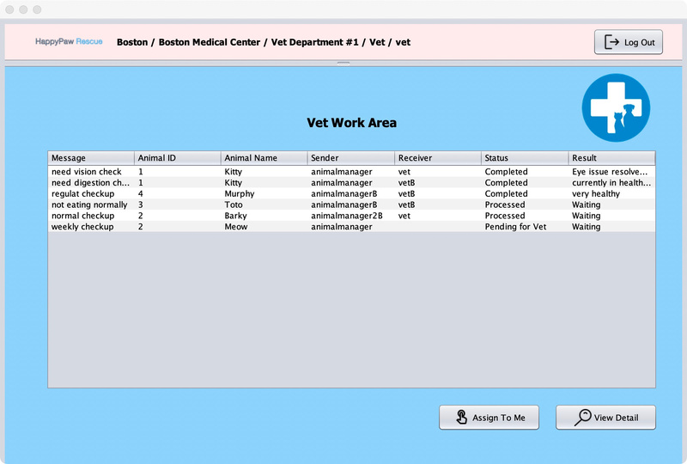
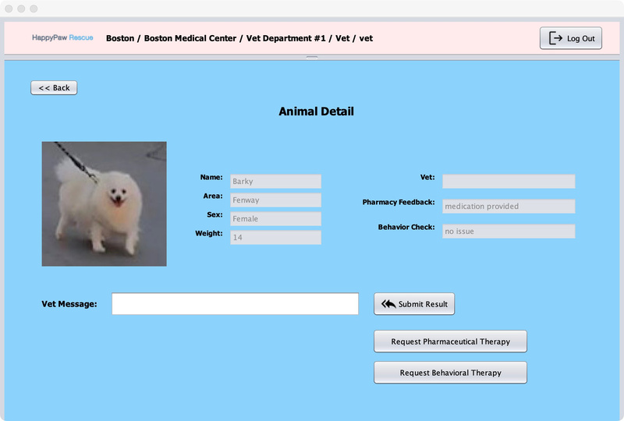
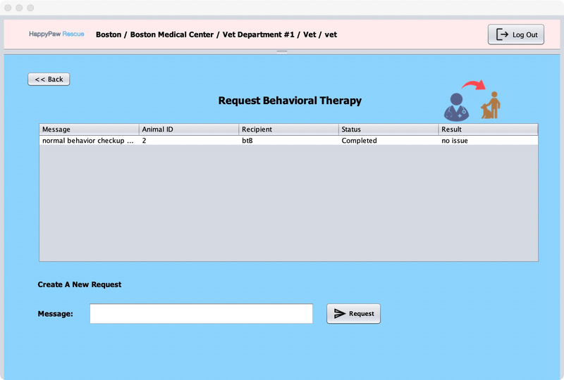
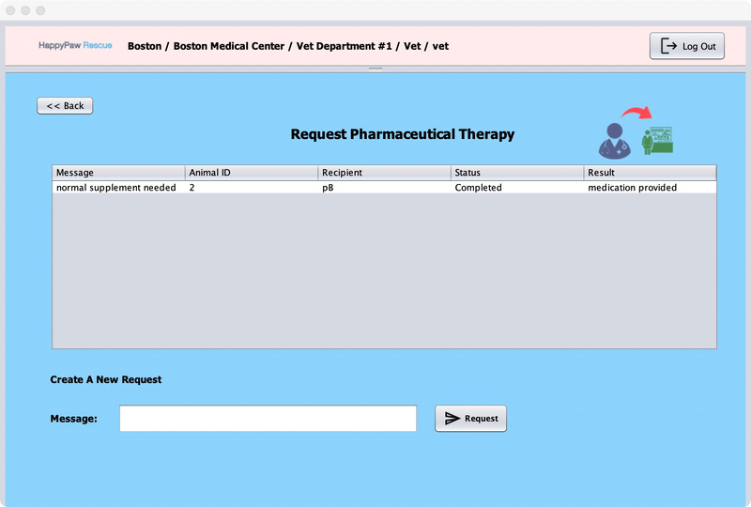
Vet
Login page
View animal
View details
Request behavior check
Request pharmacy

Slide 23
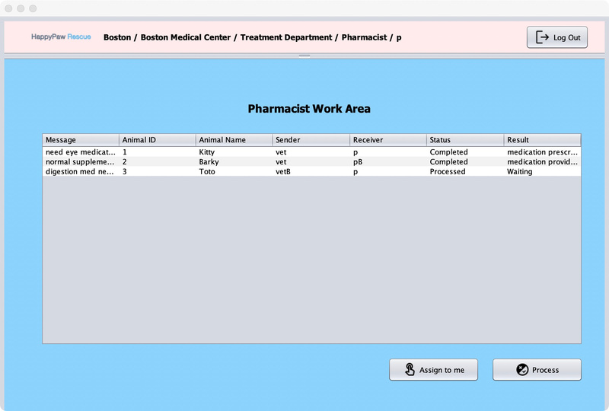
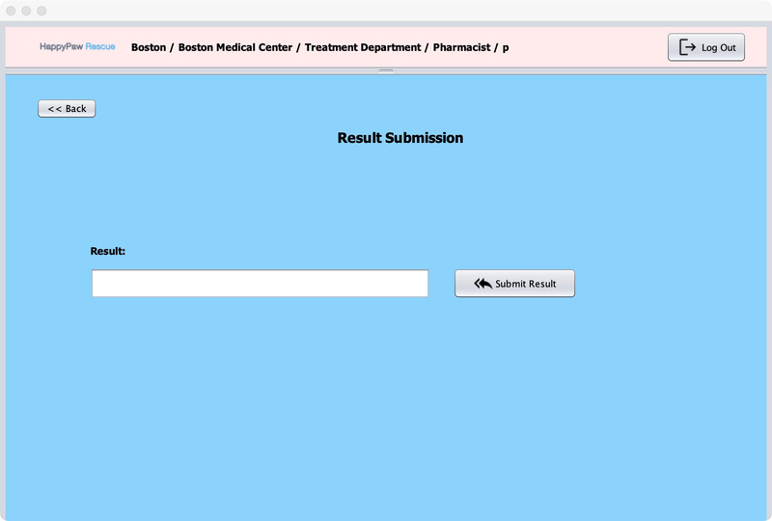
Pharmacy
Login page
View work
Process task

Slide 24
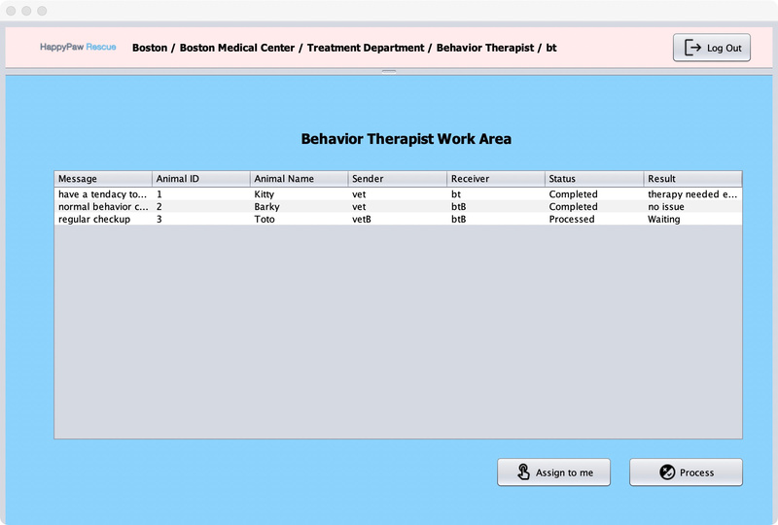
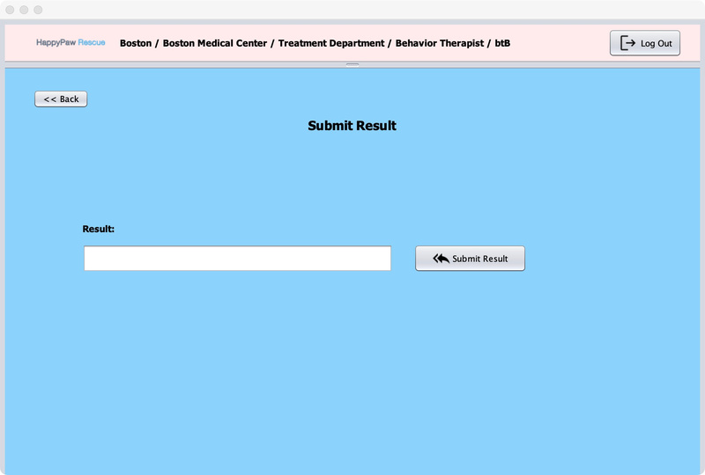
Behavior therapist
Login page
View work
Process task

Slide 25
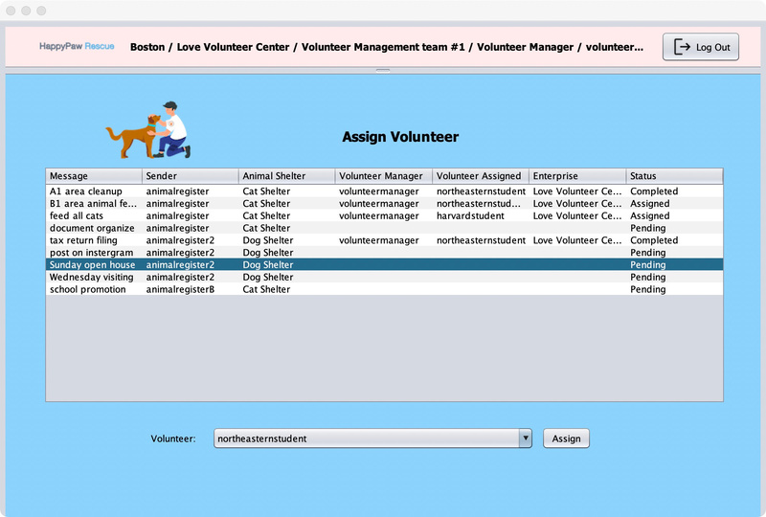
Volunteer manager
Login page
Assign a volunteer

Slide 26
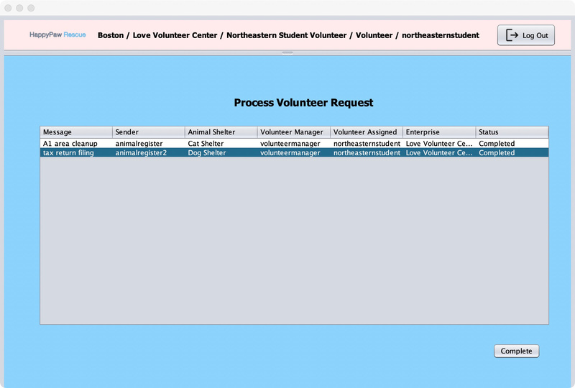
Volunteer
Login page
Report completed work

Slide 27
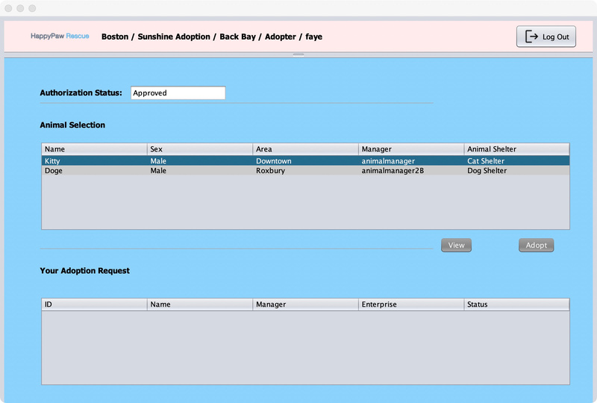
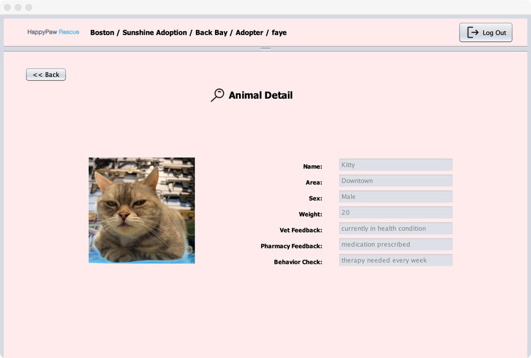
Adopter
Login page
Adoption request
View animals

Slide 28
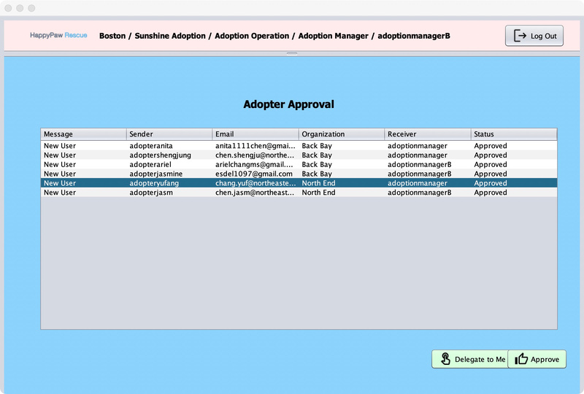
Adoption manager
Login page
Approve adopter

Slide 29
INFO 6150 FINAL PROJECT
Thank you for watching
FANYE SUN：002763553
YIFEI CHEN：002749660
JIALE LYU：002722692

